Slide 1
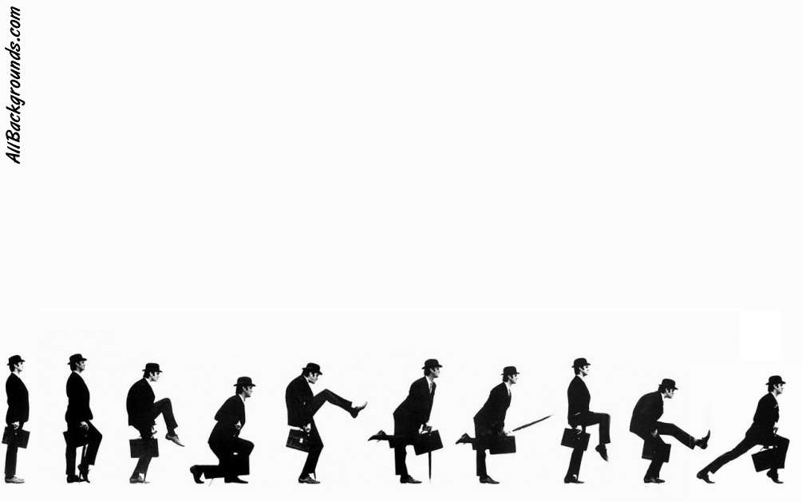
Python
Introduction to Programming
Comp07027
Lecture 10

Slide 2
Files

Slide 3
Files
While a program is running, its data is in memory.
When programs stop running, data in memory disappears.
If we want to store data permanently then we have to put it somewhere else, outside of the program.
Python can store data in external files or databases (files are simpler, but not as flexible as databases). We’ll look at files.

Slide 4
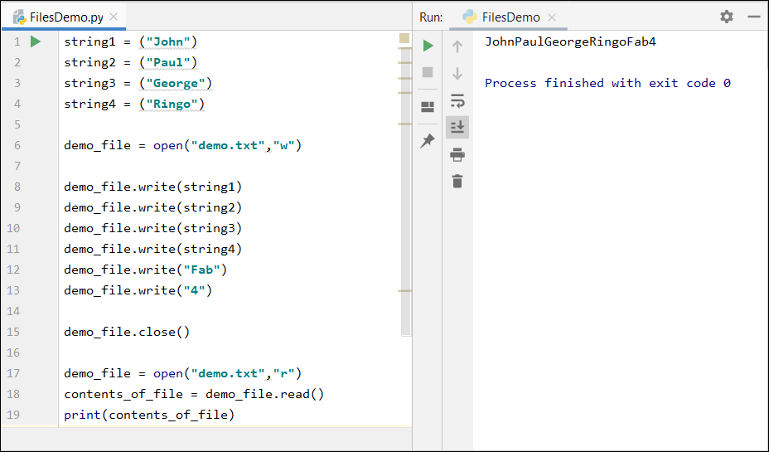
If we open a file (“demo.txt”) we create a file object and assign it to demo_file. Notice the quotes “”
The open() function has two parameters – the name (and maybe the path) of the file, and a “w” because we plan to write to the file.
Text
Files

Slide 5
If demo.txt does not already exist it will be created.
If it does exist then it will be overwritten by the new version we create.
Text
Files

Slide 6
Text
Files
To put data in the file we use the file object’s write method. We can write variables (as long as they contain strings) or we can write values directly (again, only if they are strings)

Slide 7
Text
Files
When we have finished writing to the file we call its close() method.
This closes and saves the text file and makes it available for reading later.

Slide 8
Text
Files
To read the file we open and assign it exactly as before except that instead of “w” the second parameter is “r”, indicating that we want to read it.

Slide 9
Text
Files
The contents of demo.txt are assigned to contents_of_file and this string variable can be used e.g. printed

Slide 10
The output from the print() function is one string of text corresponding to the six strings written to the file earlier. Notice that they are concatenated with no space between.
Text
Files

Slide 11
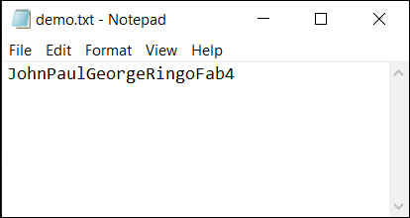
Text
Files
The text file can be viewed in notebook (for instance). Notice that the strings are concatenated here too.

Slide 12
Text Files
This way of saving data is effective (we can store & retrieve) but is decidedly limiting. We can only store strings!!
Therefore anything we want to store has to be converted to a string (in the last example we stored “4” not 4)
There is a more useful way – one which preserves data types

Slide 13
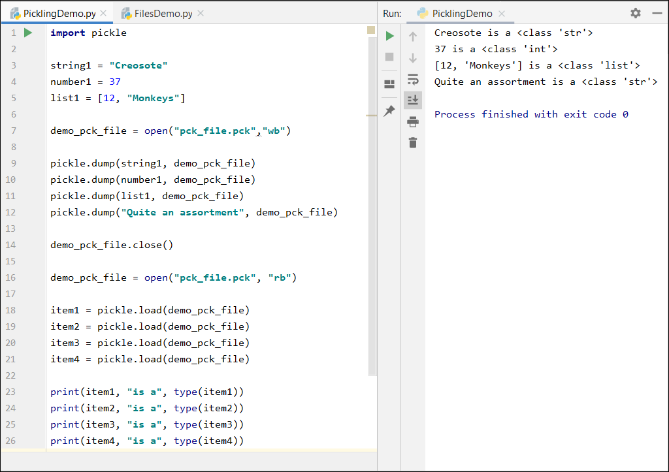
Pickling
The basic procedure for saving to a pickle file is the same (with some slightly different commands).
However, the big difference is that the original data types are preserved.

Slide 14
Create three variables, a string, a number and a list
Pickling

Slide 15
Create three variables, a string, a number and a list
Open a pickle file “pck_file.pck” and use “wb” to write to the file
Pickling

Slide 16
Create three variables, a string, a number and a list
Open a pickle file “pck_file.pck” and use “wb” to write to the file
Pickling
dump each of the variables into the file

Slide 17
Create three variables, a string, a number and a list
Open a pickle file “pck_file.pck” and use “wb” to write to the file
Pickling
dump each of the variables into the file
close the file

Slide 18
Pickling
We can then open the pickled file “pck_file.pck” again and use “rb” to load from it.
We need a separate load for each element (in order). Now we can use them e.g. print them.

Slide 19
Files
Text files
are human readable
only handle strings
easily parsed by many other programming languages
Pickled files
are NOT human readable
preserve data structures and types (with some limitations)
Data can only be reconstructed by Python applications

Slide 20
Pickled Files
Files are external to, and independent of, the program.
Therefore we can’t manipulate them directly.
We need to bring the contents of the file into the program.
It makes sense to store data in a useful structure, like a list, because Python provides us with methods to manipulate a list when we bring it into the program.

Slide 21
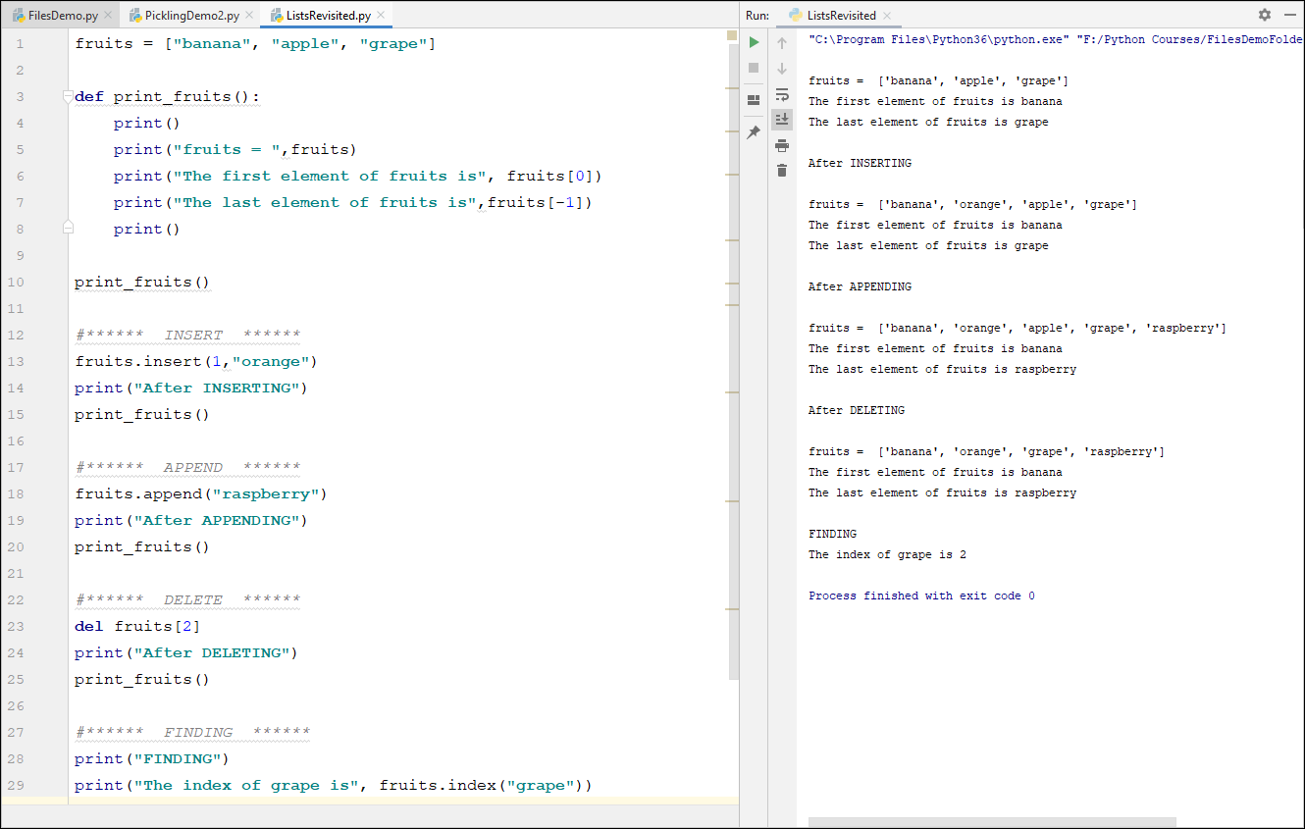
Lists
Revisted
Recall from the last lecture:
insert
append
delete
find
We looked at this in a bit of detail in the previous lecture

Slide 22
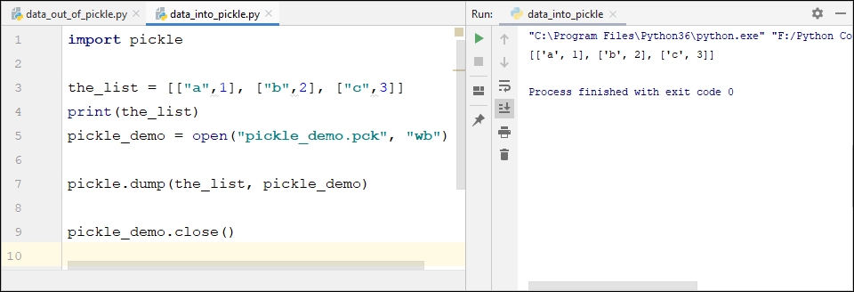
Pickled Files and Lists
We have seen that
lists are very handy
for storing different
types of data.
We can create a list, and pickle it.
This program creates our list in a python program and finishes by “dumping” the list into an external pickled file called, in this case, pickle_demo.
This only needs to be done once.

Slide 23
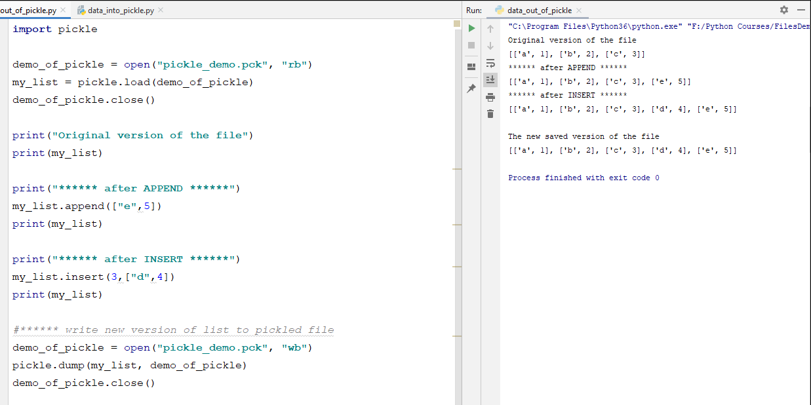
Pickles
and
Lists
This second program makes use of the pickled file pickle_demo that we created previously in another program.
This program begins by “loading” the list in the pickled file into the local list called my_list.
We can then treat my_list as we would any other list

Slide 24
Pickles
and
Lists
We can now load the list we had pickled.

Slide 25
Pickles
and
Lists
We can now load the list we had pickled.
When we have the list back in the program we can use all the functions and methods of lists.

Slide 26
Pickles
and
Lists
We can now load the list we had pickled.
When we have the list back in the program we can use all the functions and methods of lists.
When we have finished manipulating the list we can pickle it again

Slide 27
Exercise 1
Create two programs
The first should create an empty list (which will contain strings representing Scottish cities or towns) and save it to a pickled file.
The second should
retrieve the list.
allow the user to change the data (add, delete, view, find)
save it.
Run program 1 once.
Run program 2 multiple times, editing the list each time.

Slide 28
Exercise 2
Edit Exercise 1 to allow the name of the town/city and its population to be stored/edited/retrieved.
Hint:
You could create a list of lists, each of the nested lists have two elements – name and population

Slide 29
Questions??

